Slide 1

Case Study 2 DDSAnalytics Attrition
By
Adeel Qureshi

Slide 2
Agenda
Objectives
Exploratory Data Analysis
Attrition Classification Model
Monthly Income Prediction Models
Conclusion

Slide 3
Objectives
Our departments task is looking into reasons for attrition at DDSAnalytics. Understand what is causing the employees to leave DDSAnalytics and provide management with the findings.
Outcomes from this study:
Workforce planning
Employee Training Programs
Retaining Employees
Identifying high potential employees
Reduce/preventing voluntary attrition.

Slide 4
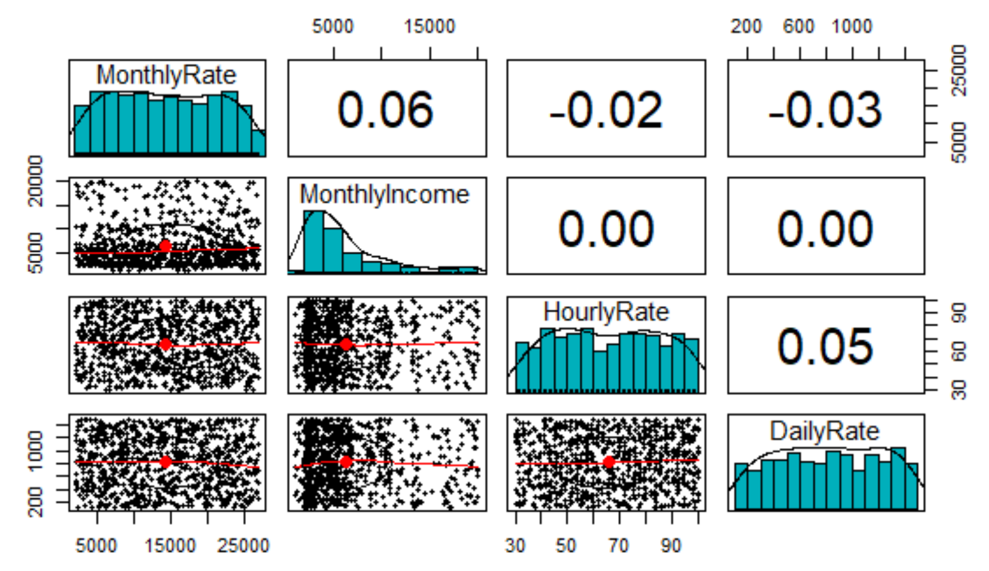
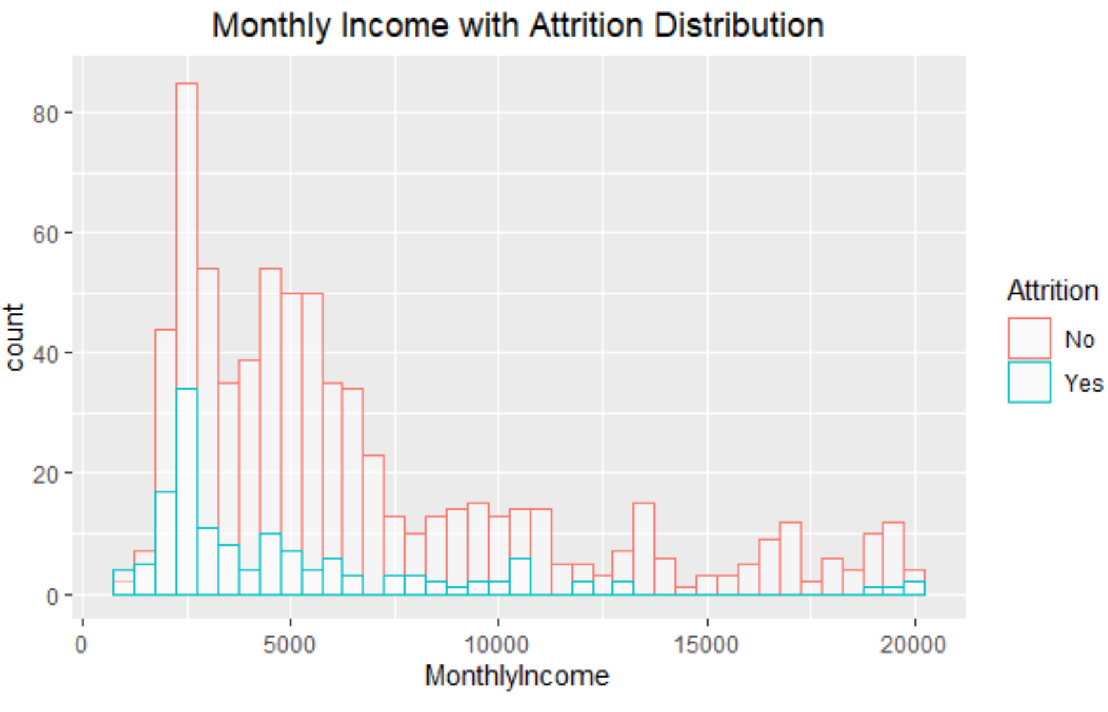
Exploratory Data Analysis(EDA)
No Value - Over18, EmployeeCount, Performance Ratings & StandardHours.
HourlyRate, DailyRate & Monthly Rate does not have clear explanation to use. Since we cannot tell the purpose of Daily Rate and Hourly Rate.
Monthly Income was selected to be used in this study.

Slide 5
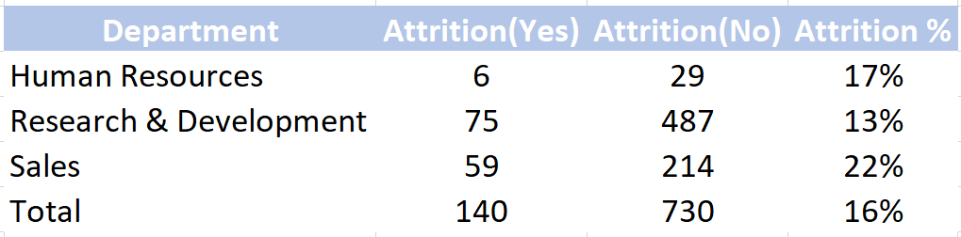
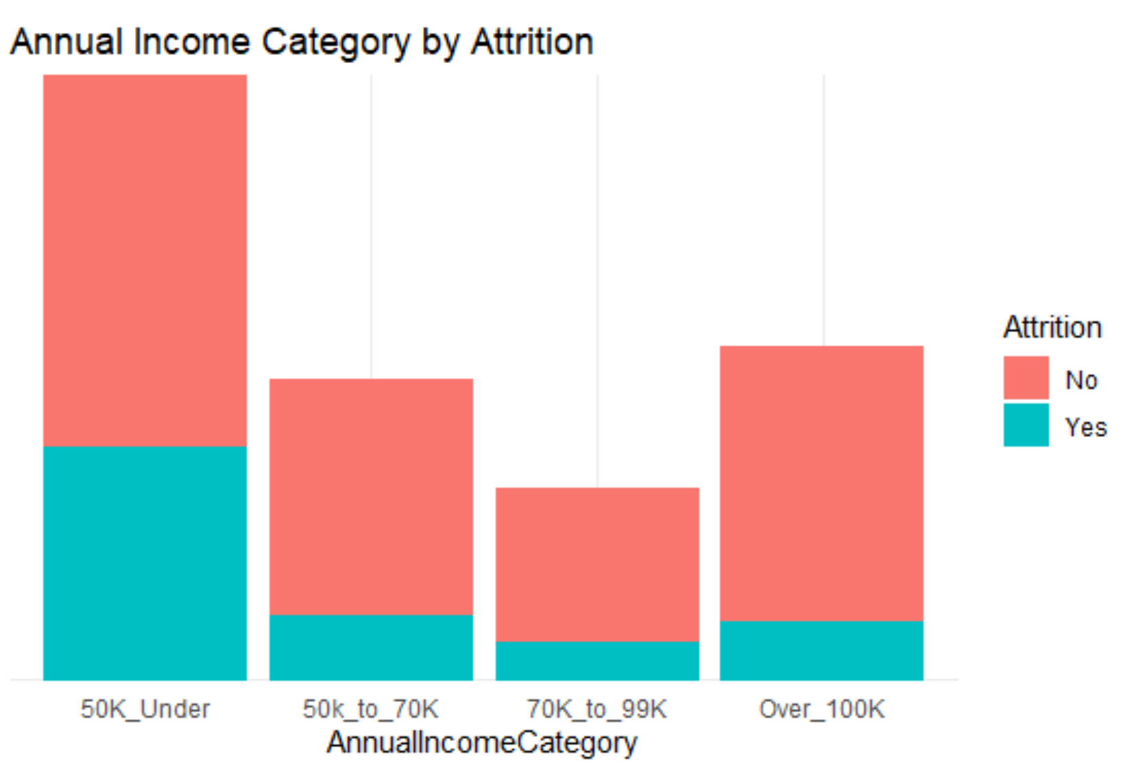
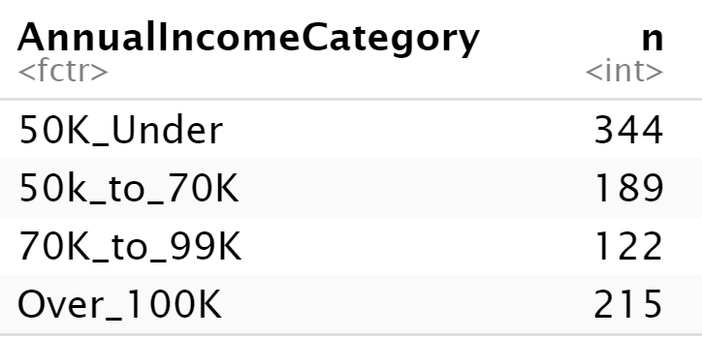
Data broken out in 4 categories by annualizing the monthly income.

Slide 6
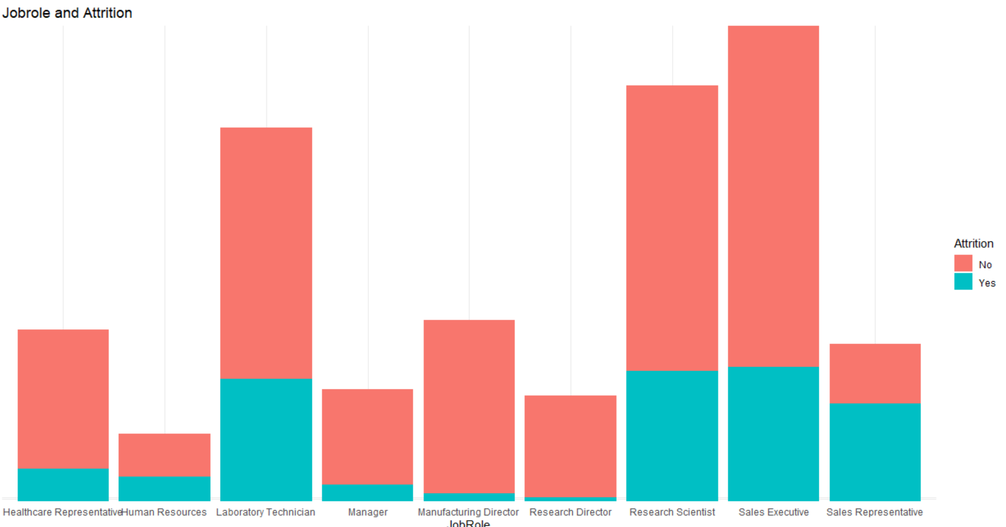
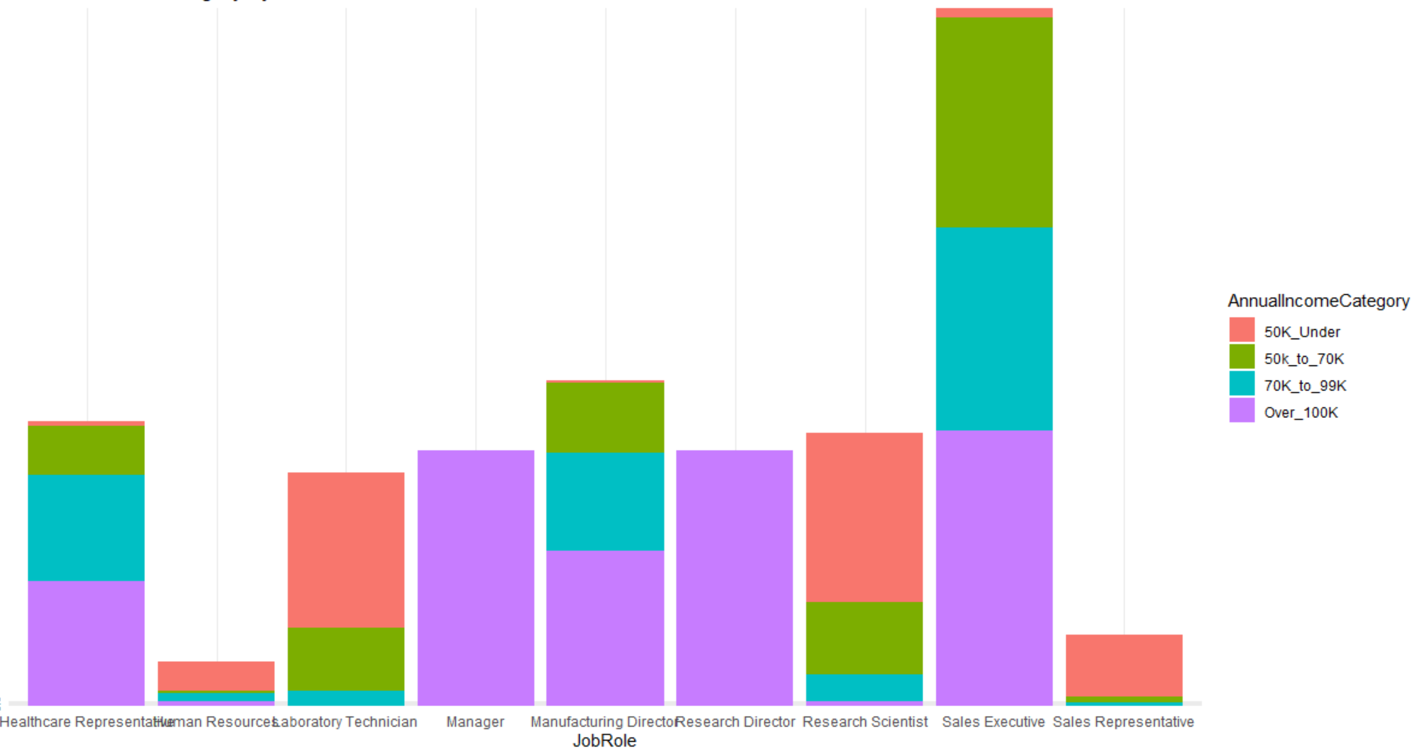
The jobs that are highest at risk of attrition are:
Laboratory Technician
Research Scientist
Sales Executive
Sales Representative

Slide 7
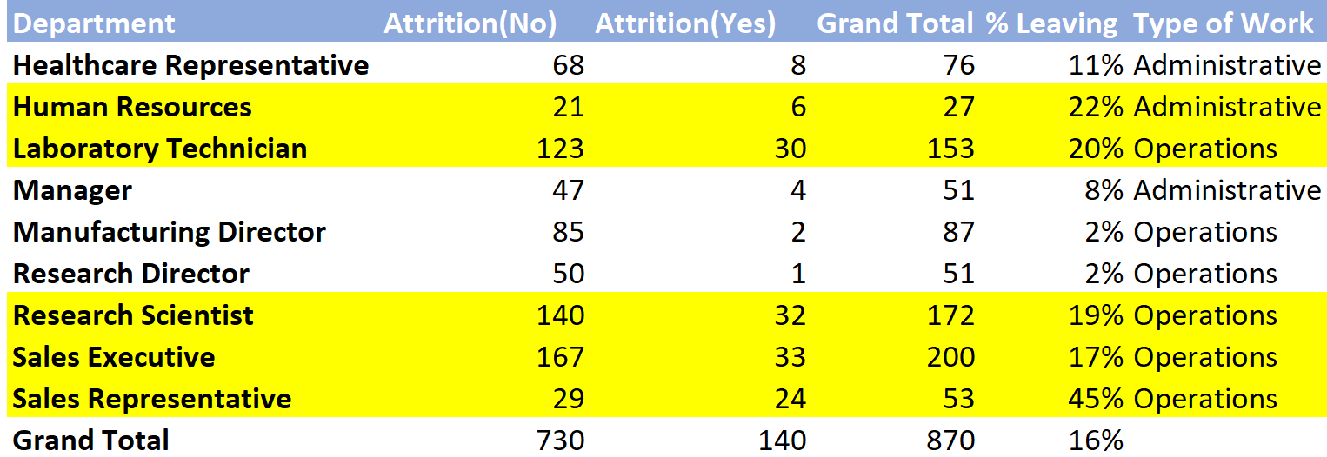

Slide 8
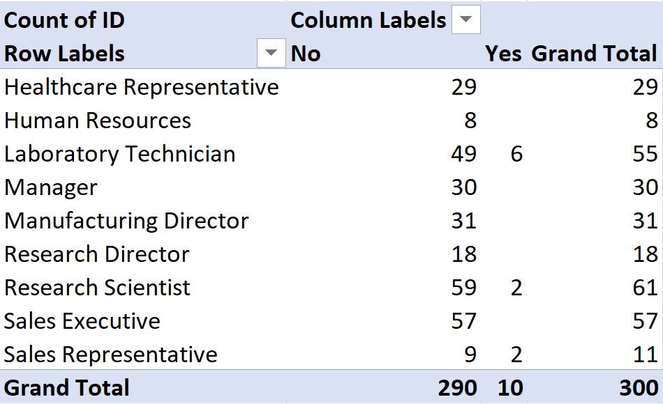
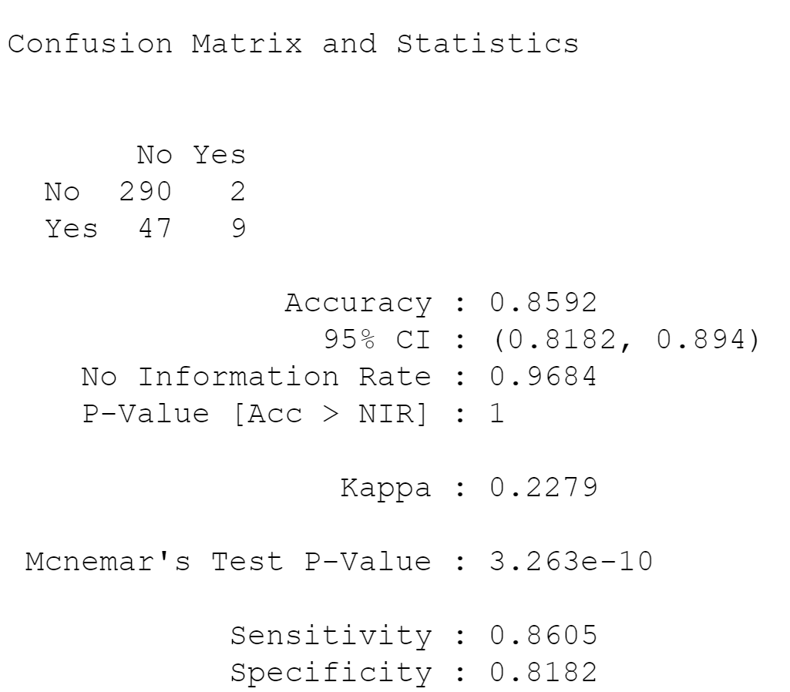
Attrition Classification Model
KNN Model attrition results
Operations roles are high risk of attrition based on our KNN model.

Slide 9
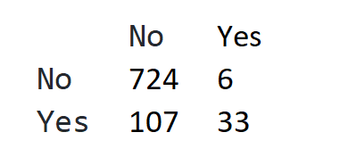
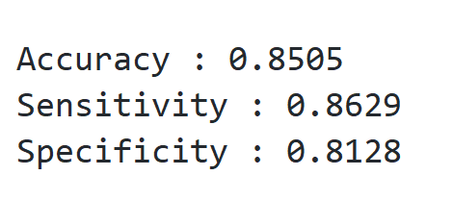
Monthly Income Prediction Models
Linear Regression Stepwise Model
Help identify if employees are being according to experience, job role, education.

Slide 10
Conclusion
We have identified that lowest salary workers at the risk of attrition.
In our study we have identified the following factors as important DistanceFromHome, JobLevel, TotalWorkingYears, YearsWithCurrManager, Age, Department and JobRole for attrition and salary forecasts.
Programs should be developed to evaluate whether workers are being paid market rate or below market.

